Slide 1
Finding Stock Market Inefficiencies
Analysis by Brian Bentson

Slide 2
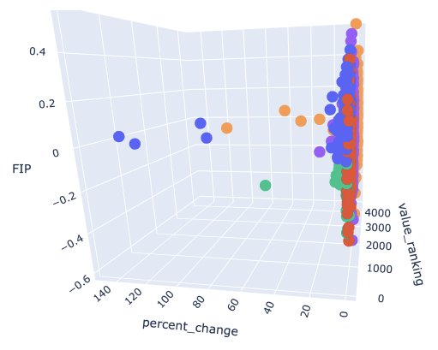
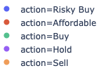
Finding Stock Market Inefficiencies
This analysis focuses on finding which stocks offer the unique combination of low cost and low volatility growth in the stock price.
1
Use machine learning to find which companies to Buy
2
Use anomaly detection to find data quality issues
3
Visually interact with KPI’s to research potential stock purchases and sales
Stocks Grouped by Recommended Action after analysis of 3 key factors:
The value of the stock which is its price relative to its performance
The percent change of a stocks price over the past 1 year
The price momentum or volatility (FIP metric) over the past 1 year

Slide 3
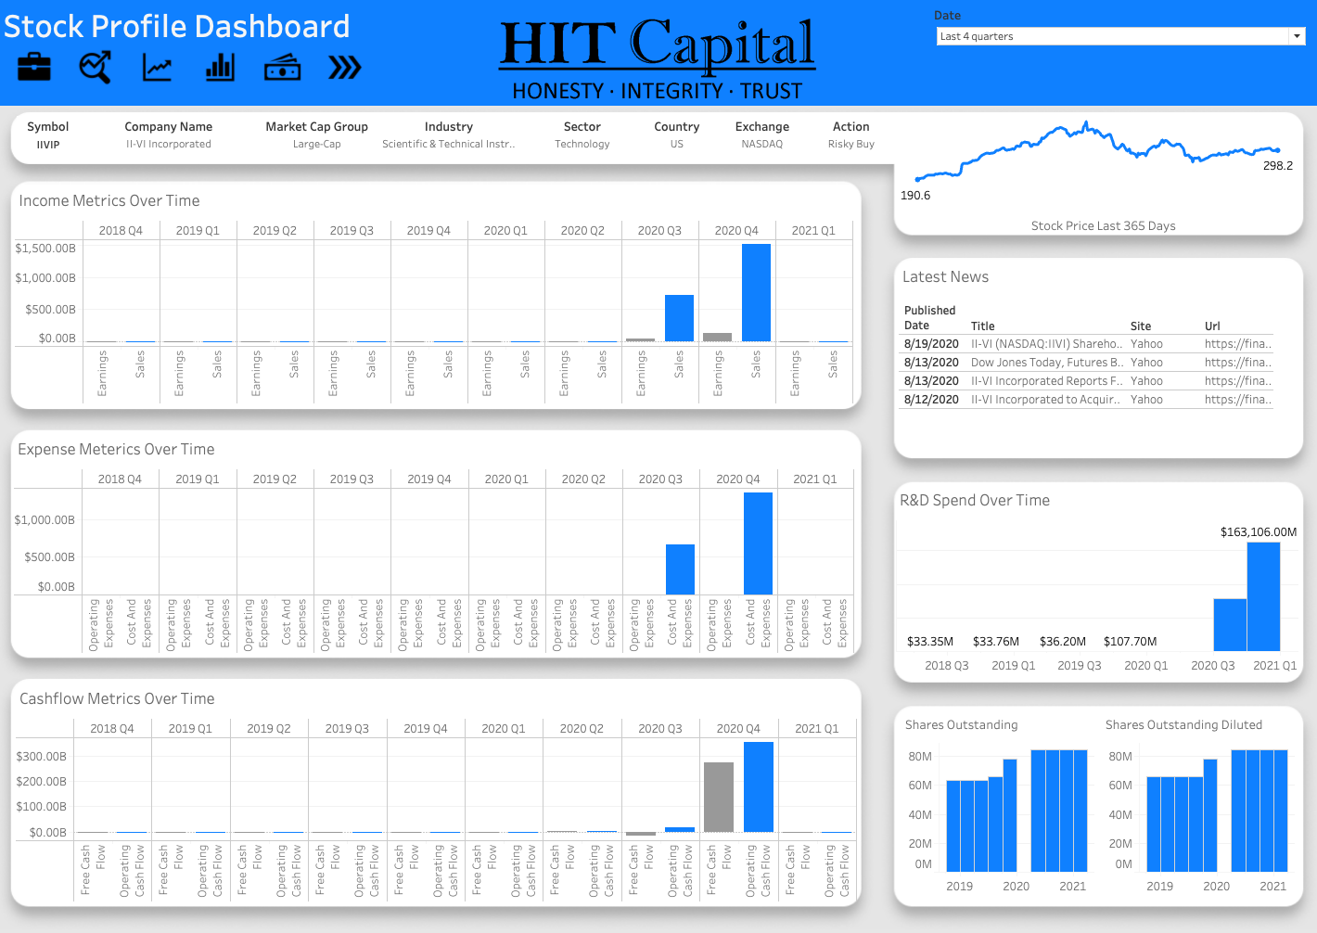
Machine Learning Results
Two algorithms were used to solve separate problems. Classification was used to identify inefficient stocks (Buy) and anomaly detection was used to identify questionable data quality.
Classification
Anomaly Detection
Percentage Correctly Classified
Symbol | Revenue Per Share | PE Ratio | PS Ratio | EV to EBITDA | EV to Free Cashflow | EV to Operating Cashflow
IIVIP | 26,456 | 0.14 | .01 | .07 | .1 | .07
Sell
98%
Affordable
96%
Action
94%
Hold
Buy
93%
Risky Buy
92%
Model Feature Importances
EV to Operating Cashflow
EV to EBITDA
EV to Free Cashflow
Percent Change
Price to Sales Ratio

Slide 4
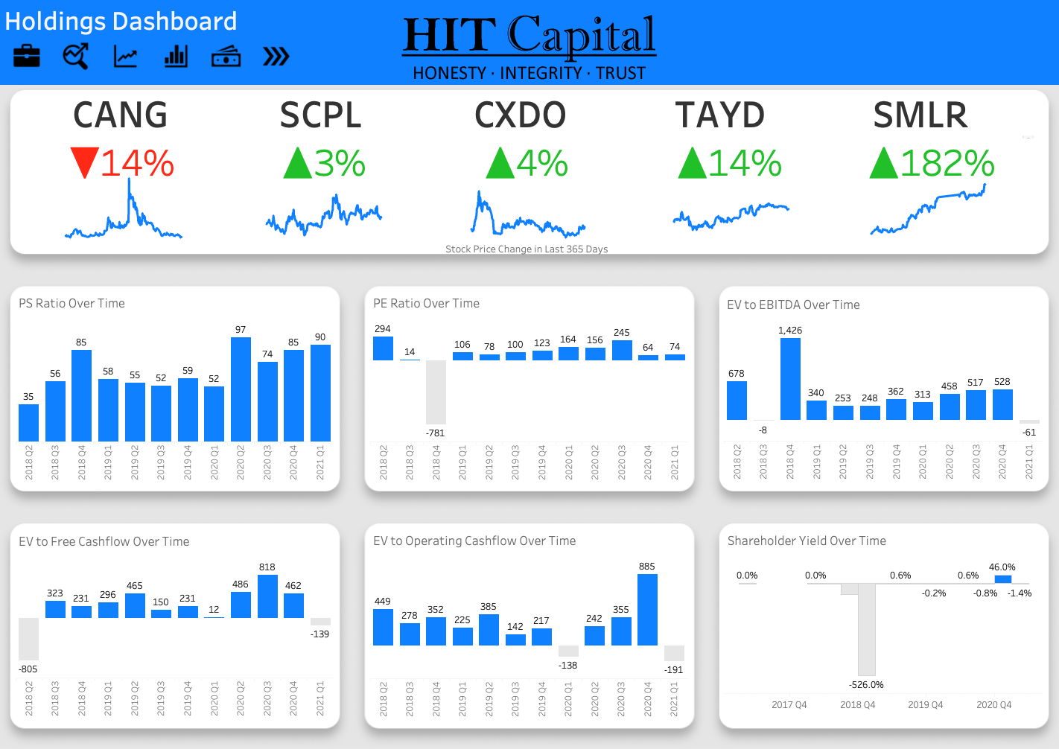
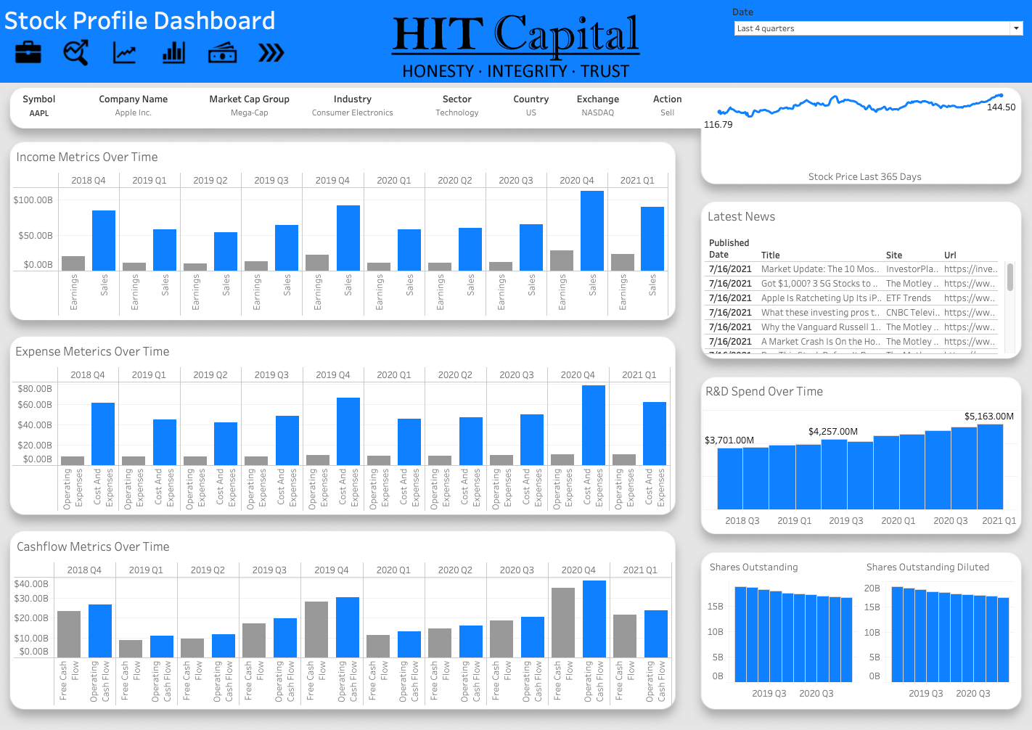
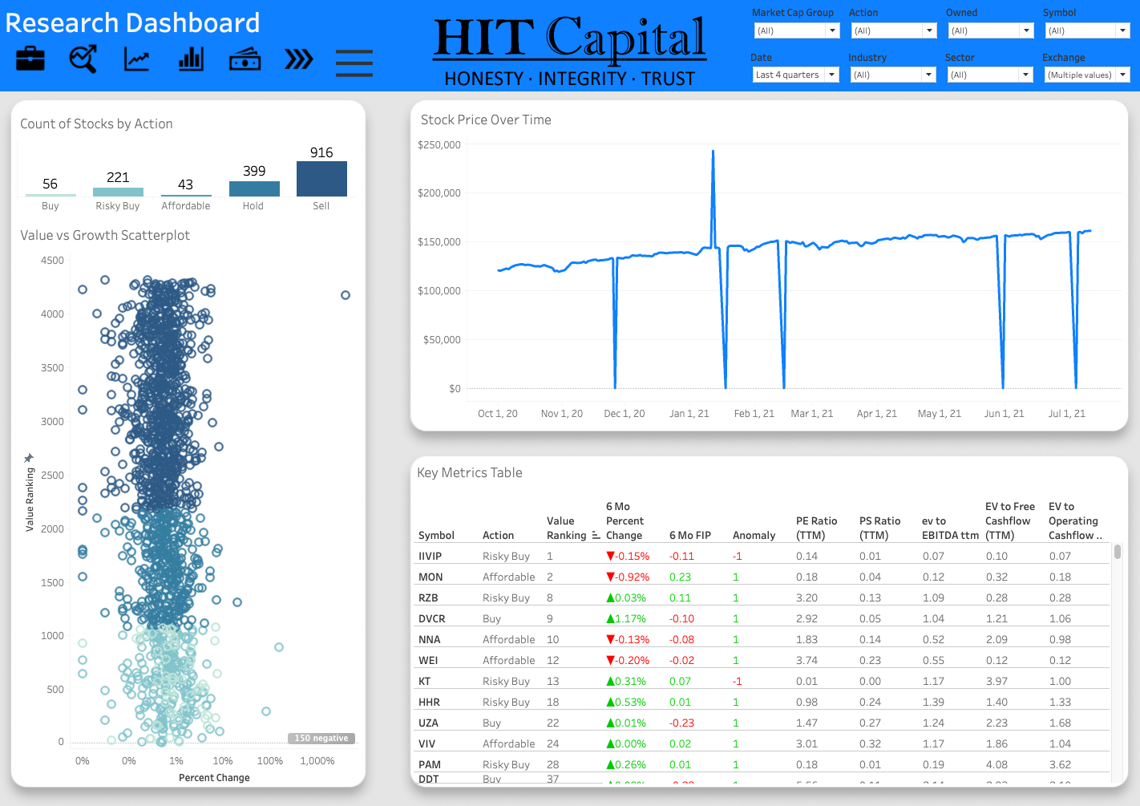
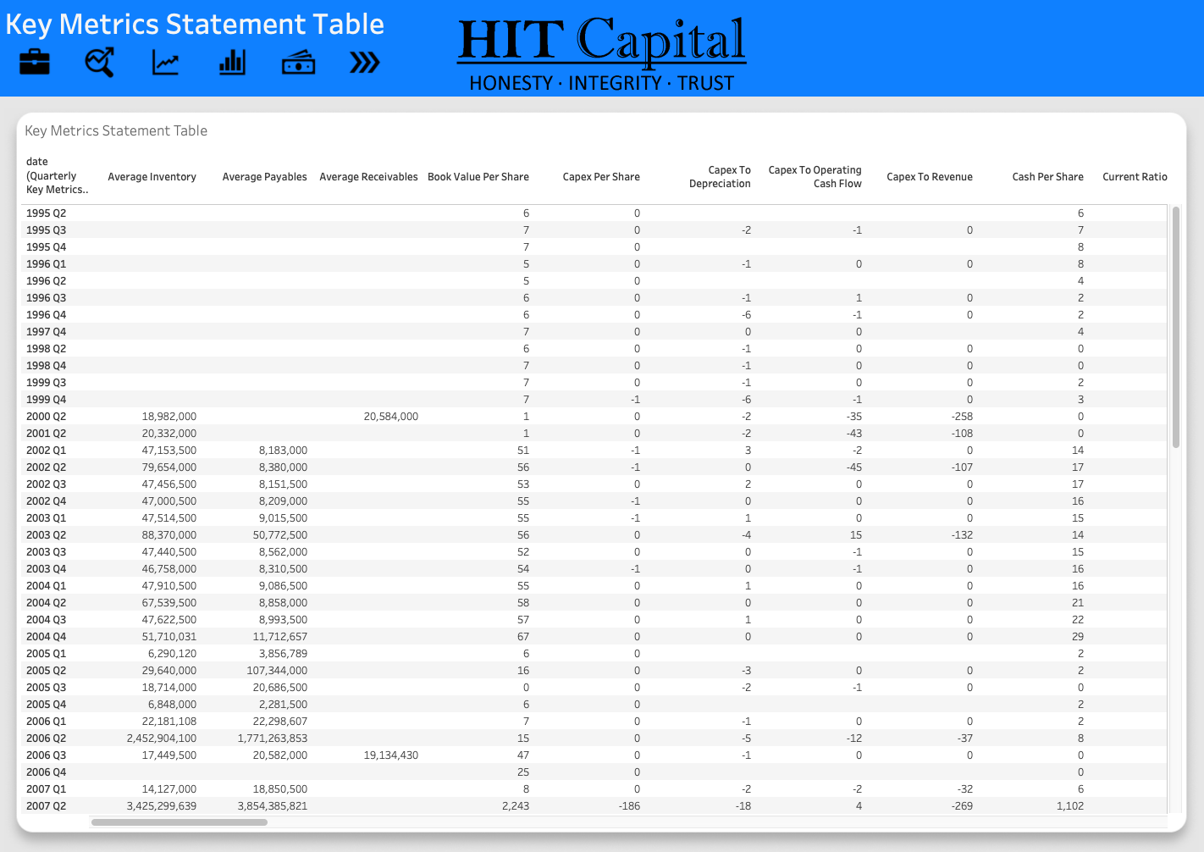
Stock Performance Dashboard
A Tableau dashboard was built to aid in the discovery of inefficient stocks. The dashboard allows a user to explore key stock information in an interactive visual experience.
3 Main Dashboard Functions:
1
View performance of current holdings for potential sale
2
Research new companies to buy
3
Validate underlying data quality

Slide 5
Dashboard Demo

Slide 6
Recommendations & Improvements
Based on analysis findings, it is possible to utilize historical stock metrics to prioritize which stocks to further evaluate for investment.
Recommendations
Future Improvements
Utilize anomaly detection results
Make a Live Connection
Quickly know which stocks to dive deeper into their data to ensure quality
Create a live pipeline which feeds refreshed data to the dashboard automatically
Focus on Enterprise Value to Free Cashflow
This metric provided a great metric to the classification algorithm to group the stocks into their respective categories
Explore the Dashboard
The dashboard integrates many import stock metrics in an interactive way that should speed up evaluation

Slide 7
Thank you
Questions?

Slide 8
Appendix

Slide 9
Data Overview
FMP
Sourced data from FMP’s API
4311 stocks after removing null or negative values and removing highly volatile sectors
Pulled company profile information, historical performance metrics and stock price
Financial Modeling Prep

